Slide 1
95 Express Lanes - Fredericksburg Extension (Fred Ex) Project
Proposed Noise Barriers Update
Notes:
Thank you for joining us!
We’d like to take a few moments to chat with you about the Fredericksburg Extension Project—also known as Fred Ex.
As part of this project, several noise barriers have been proposed along the I-95 corridor.
We’d like to share an overview of how the noise barrier process works and what to expect in the weeks ahead, as community voting on the barriers gets underway.

Slide 2
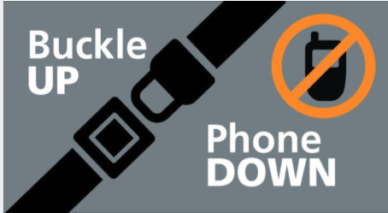
Safety moment
  Traffic down doesn’t mean speed up!
  There may be lighter traffic and fewer crashes on the road due to COVID-19, but there has also been an uptick in the percentage of fatal crashes involving speed and lack of seat belt use.
  Don’t drive distracted.
  Buckle up and slow down.
Notes:
Before we begin, we want to emphasize that safety is the foundation of all we do. Our Fred Ex team builds safety in at all levels of the project, from design to construction to even routine daily meetings.
To reinforce our focus on safety, we begin each meeting with a dedicated safety moment.
Today, we’d like to remind you of the basics: slow down and wear your seat belt.
VDOT has recently seen a rise in crash fatalities because folks are speeding and forgetting to wear seatbelts.
With all the construction projects going on in the corridor, it’s even more critical to slow down and avoid distractions when driving–both for your safety and for the safety of our workers who are really putting themselves in harms way to make these improvements to our roads.
If you have new/young drivers in your life, remind them to slow down and buckle up. The more reminders we can all get, the better!

Slide 3
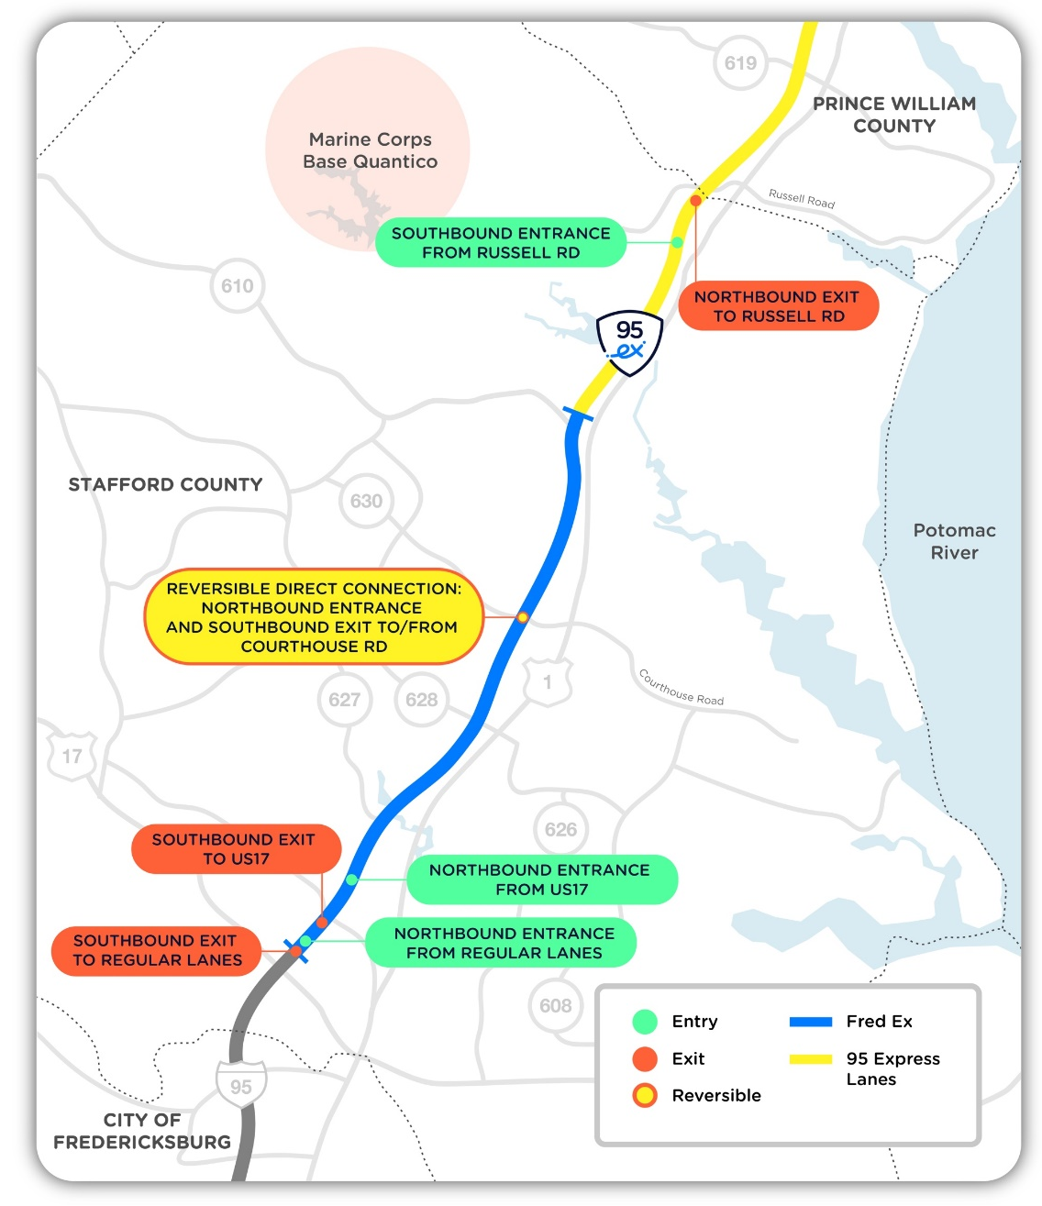
Fredericksburg Extension overview
The Fred Ex Project will extend the existing 95 Express Lanes south another 10 miles along the I-95 median.
The extension will span from the current end of the 95 Express Lanes, just past Route 610 in Stafford County, to near Route 17.
The project will include new access points to the existing 95 Express Lanes, construction of new ramps for access to Quantico and Old Courthouse Road, and the addition of 7 new bridges.
Construction began in July 2019 and the lanes are slated to open in late 2022.
When completed, the extension will join the existing network, creating an uninterrupted Express Lanes corridor between the Potomac and Rappahannock Rivers.
Notes:
In a nutshell, Fred Ex will lengthen the existing 95 Express Lanes another 10 miles south, along the 95 median.
The new lanes will pick up where the existing lanes end and extend to near Route 17.
As part of the project, new ramps to Quantico and Old Courthouse Road will be constructed and 7 bridges will be built.
Construction began in July and the lanes are scheduled to open to the public in late 2022.
Once the lanes are open, they’ll connect to the existing Express Lanes network (including the 395 lanes, which are now open), creating an Express Lanes corridor up to DC.

Slide 4
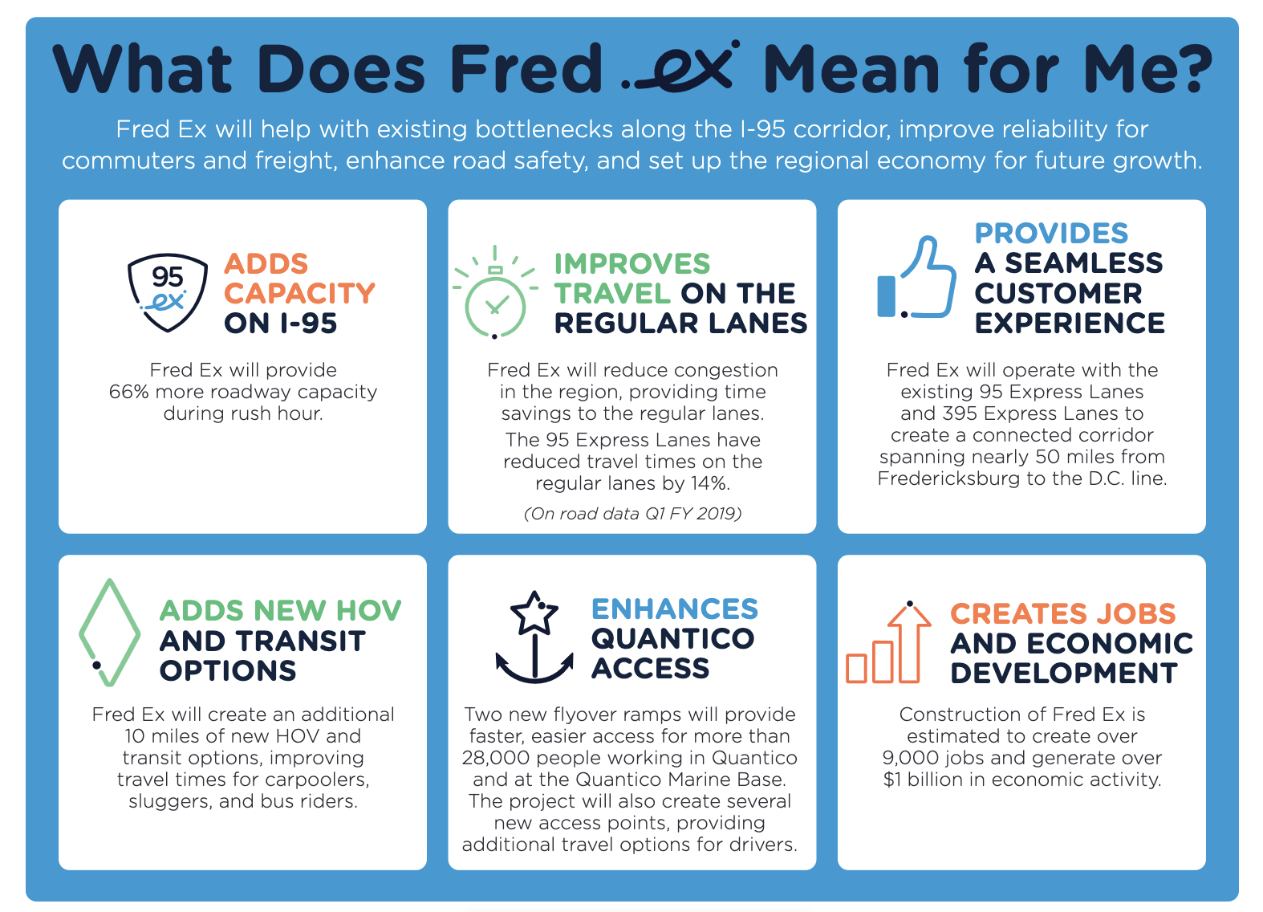
Notes:
Fred Ex will help bring some relief to the routine traffic bottlenecks that occur in this part of the 95 corridor.
Even if you don’t use the lanes, you’ll still reap the benefits, which include:
Additional roadway capacity -- 66% increased capacity during rush hour.
Reduced overall congestion – existing lanes have reduced travel times in the general purpose lanes by 14%.
As mentioned earlier, Fred Ex will connect with the existing Express Lanes corridor, connecting nearly 50 miles up to the DC line – a major gain for commuters and travelers through the region.
Commuters can take advantage of new HOV options and enhanced access to Quantico via new flyover ramps.
As part of the project, Transurban is also providing a $277 million payment to the Commonwealth for use on other transportation projects, including the Northbound Rappahannock River Crossing project.

Slide 5
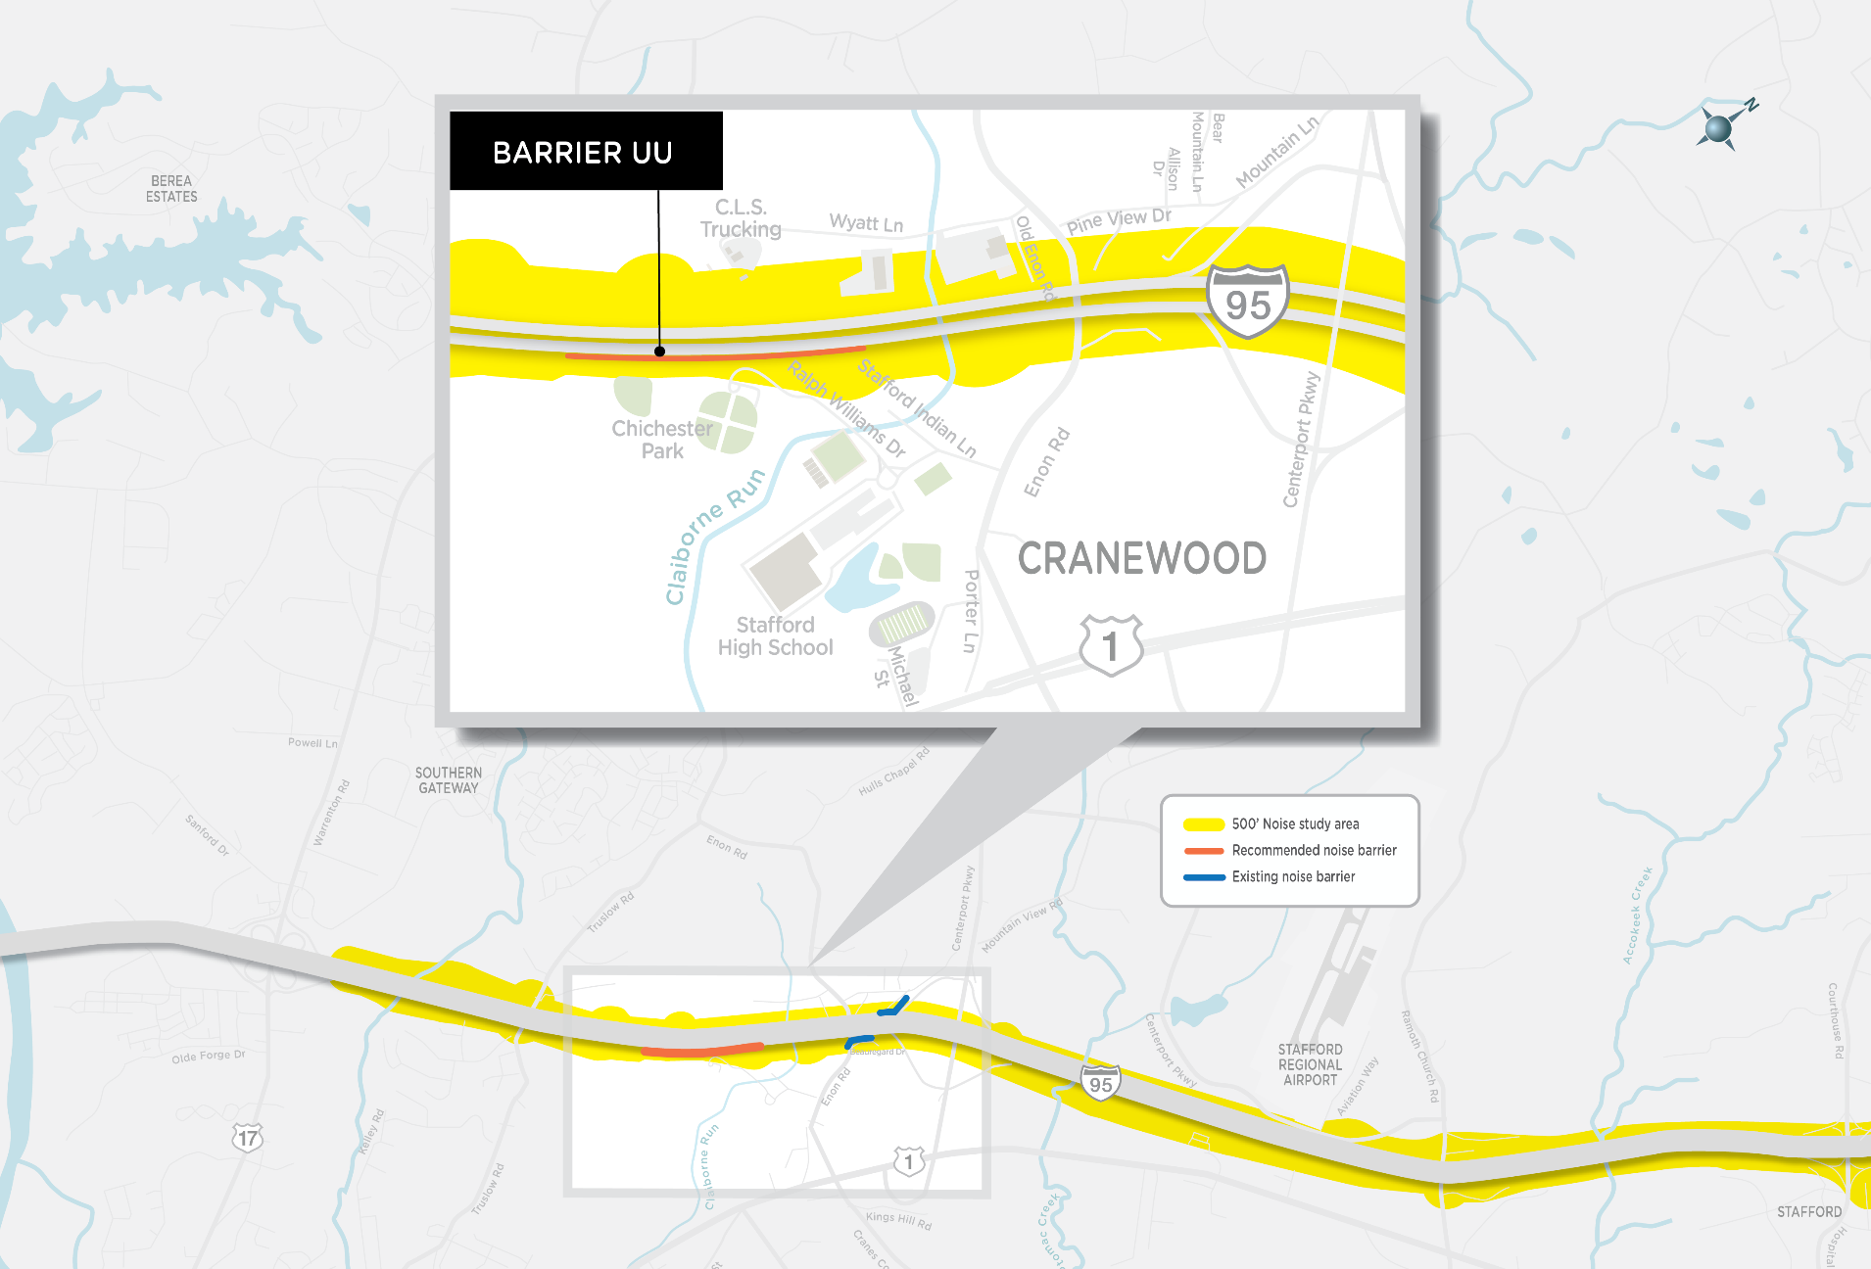
Proposed noise barriers
Notes:
On this slide and the next, you’ll see the locations of each of the three noise barriers being proposed for the Fred Ex Project.
Proposed barriers are denoted in orange. This map shows one proposed barrier, barrier UU.
The proposed barrier UU would be located along I-95 northbound, near Chichester Park and the athletic fields at Chichester Park.

Slide 6
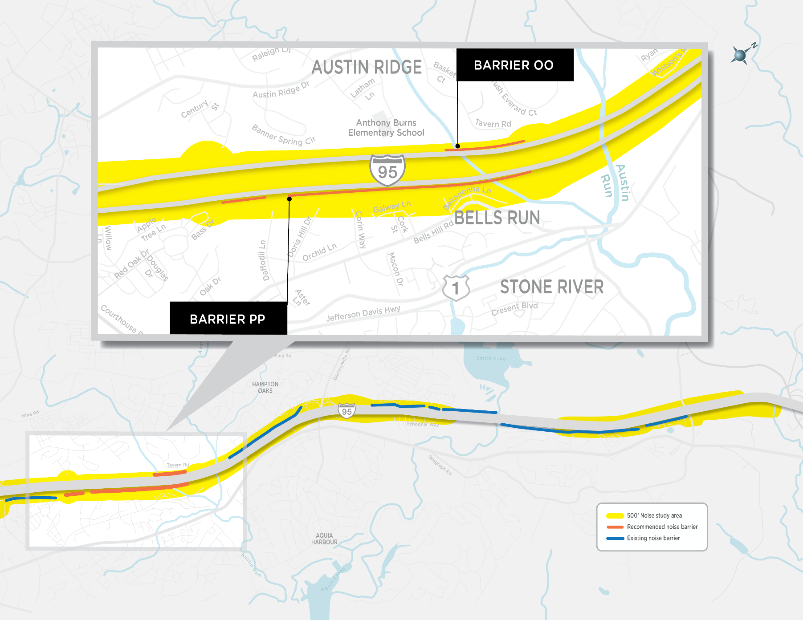
Proposed noise barriers
Notes:
This map shows the final two barriers proposed—Barriers PP and OO—again denoted in orange.
Next, we’ll talk about the noise analysis process.
Later in this presentation, we’ll talk in a bit more detail about who will be asked to vote on each of these barriers.
The proposed barrier PP would be located along I-95 northbound, from south of Route 610/Washington Drive to the residential neighborhood on Daffodil Lane.
The proposed barrier OO would be located adjacent to Tavern Road along I-95 southbound.
Barrier names are associated with the Common Noise Environment (CNE) segments studied within the noise study area.

Slide 7
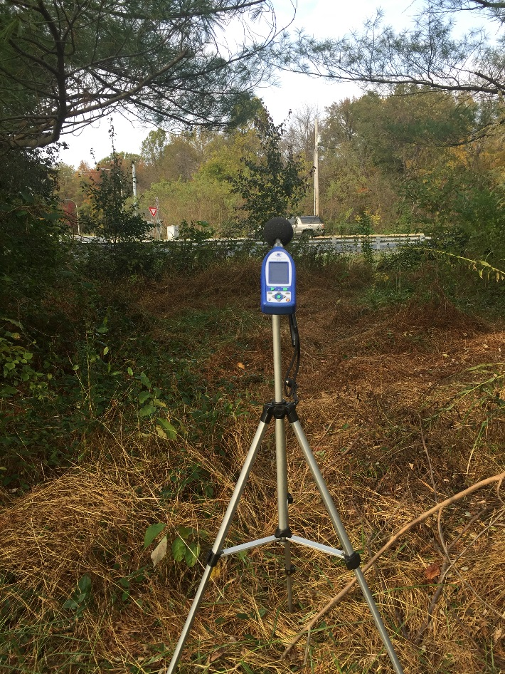
Noise analysis
As part of the environmental analysis conducted during the NEPA analysis, VDOT conducted a noise impact assessment which included:
  Identifying noise receptors (such as residences, schools, parks, etc.)
  Conducting noise monitoring in the field
  Conducting noise modeling
  Identifying impacts
  Designing and assessing mitigation
  Preparing and presenting noise study results and preliminary noise barrier locations (if necessary) at public meetings.
Notes:
VDOT’s noise barrier evaluation process follows federal regulations set by the Federal Highway Administration (FHWA). These regulations dictate how locations are assessed for noise barriers and how a determination is reached to install one.
As part of the environmental analysis conducted during the National Environmental Policy Act (NEPA) analysis, VDOT performs an initial noise impact assessment. This includes identifying noise receptors (such as residences, schools, parks, etc.), and conducting noise monitoring in the field. The proposed noise barrier locations are established from this assessment.
These noise studies are very comprehensive. They take into account all noise impacts -- including tree removal, grading, future development/growth based on residential zoning, and increased traffic associated with a project.
As part of the Fred Ex project, a secondary noise study was performed to verify the location of the noise walls required and confirm the results of the initial noise study.
That secondary study began in the summer of 2019 and took about 8-9 months to complete.

Slide 8
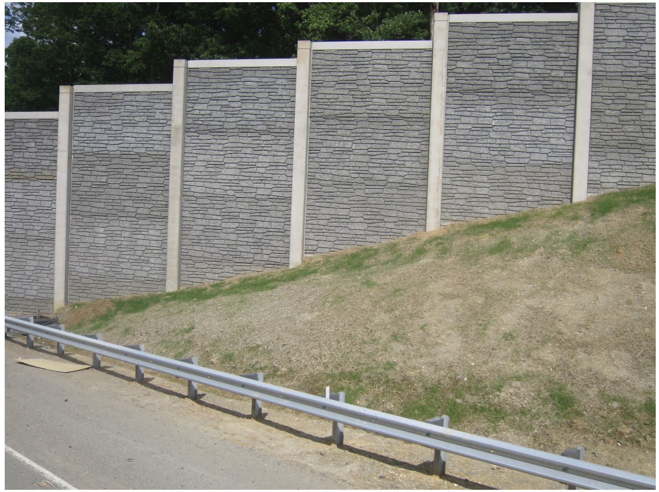
Noise barrier anticipated schedule
Late Summer/Early Fall 2020
Noise Study/Noise Abatement Decision Report (NADR) submitted for VDOT review
Final approval of NADR
Community voting on noise barrier installation
Winter 2021
Result of community vote included in final noise barrier plans
Fred Ex Noise Barrier Design
(Same style on both highway and residential sides)
Notes:
Here is our expected schedule for noise barrier voting activities.
Once the secondary noise study was completed, a Noise Study/Noise Abatement Design Report (NADR for short) was submitted to VDOT and the Federal Highway Administration for review and approval.
The NADR was recently approved, which in turn kicked off the community voting process for properties and residences who are impacted and/or benefited by the proposed noise barriers.
Once voting is completed, the results will be added to the final NADR and the report will be finalized – likely sometime in the winter of 2021.
On this slide, you’ll see a photo showing the the design and aesthetic of the noise barriers being proposed as part of the Fred Ex Project. These designs are predetermined and will be consistent with the existing barriers in the Stafford County I-95 corridor.

Slide 9
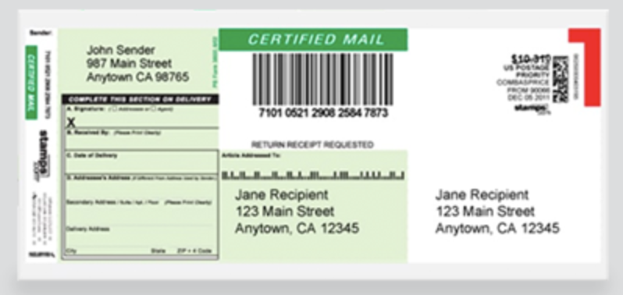
Noise barrier voting process
Community voting process
Benefited residents vote on the installation of a noise barrier in their community.
Initial noise barrier opinion survey and background information will be sent by certified mail to benefited residents.
Certified Mail Sample
Benefited residents will have 21 days to return their initial opinion surveys.
If an insufficient number of initial opinion surveys are returned (~50% of distributed ballots), a second round of surveys will be sent via certified mail to recipients who did not respond to the initial survey. The majority outcome of the second round will be incorporated into the final noise barrier plans.
Notes:
The outcome of this process depends on your vote and the votes of your qualified neighbors, so we are asking that you keep an eye on your mailbox!
Be on the lookout for mailings from 95 Express Lanes and HNTB Corporation – HNTB is one of our partners on this project and they are handling the noise barrier voting process and tabulation.
If you’ve been identified as a benefited resident, you should have received a pre-notification letter from 95 Express Lanes, alerting you that voting will begin soon. Along with this mailer, you should have received some supplemental information about the process, including a map of the barrier proposed for your area and a Frequently Asked Questions handout.
Next, you’ll receive an opinion survey from HNTB Corporation, along with another map of the barrier and an image of what the barrier will look like.
Once you receive your opinion survey, you’ll have 21 days to return it in an already provided postage-paid envelope. Be sure to complete and return it promptly!
If we don’t receive at least 50% of the initial opinion surveys back, we’ll send out a second round of surveys to folks who did not respond to the initial surveys.
We want to make sure you have every opportunity to make your preference heard through your vote – if you don’t receive an opinion survey or want to find out whether you’ve been identified as eligible to vote, please contact me, Brent McKenzie. I’ll share my contact information with you at the end of this presentation.

Slide 10
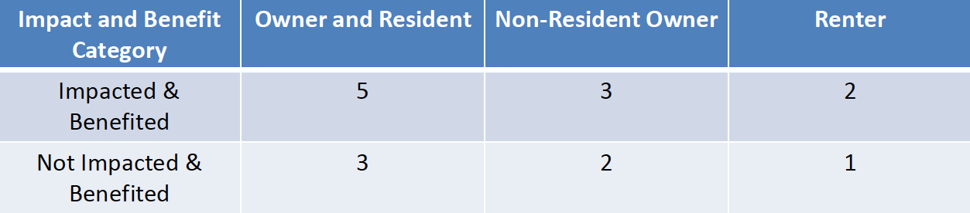
Who gets to vote and how votes are weighted
Impacted & Benefited: Exceeds the noise abatement criteria of 67 decibels and will receive at least a 5-decibel reduction with the construction of the proposed barrier.
Not Impacted & Benefited: Does not exceed the noise abatement criteria of 67 decibels and will receive at least a 5-decibel reduction with the construction of the proposed barrier.
Notes:
So who gets to vote?
During the noise analysis, engineers use computer modeling to determine which residents qualify as benefited receptors. The modeling is based on factors such loudest hour of the day, topography, distance from the road to residences, and the sound that is produced by different types of vehicles. Benefited receptors are receptors shown in the noise study to have a predicted noise reduction of 5 decibels or more from the proposed noise barriers.
If you are determined to be a “benefited receptor unit owner and/or resident” (in other words, you would benefit from the noise barrier), you will be asked to vote on the noise barrier. If you want to check to see if you’ve been identified as a benefited receptor, contact Brent.
Non-resident property owners who are determined to be benefit receptors will be eligible to vote. Their votes will be given a weight of 3. As a comparison, the votes of homeowners who are also residents will be given a weight of 5.
Renters who are determined to be benefit receptors will be eligible to vote. Their votes will be given a weight of 2.
VDOT’s noise barrier evaluation process follows federal regulations set by the Federal Highway Administration. These regulations dictate how locations are assessed for noise barriers and how a determination is reached to install one.

Slide 11
Additional resources
To learn more about noise barriers and the noise abatement process, check out the following online resources:
bit.ly/VDOTNoiseBarriers
bit.ly/FHWANoiseBarriers
Notes:
We know this can be a complex and confusing process, so we want to point you in the direction of as many resources as possible to help you understand the noise wall process and how it all works.
On this slide, you’ll see links to VDOT and Federal Highway Administration resources that can help if you have more questions or would like to review some of the technical requirements on noise barriers in the Commonwealth.

Slide 12
Staying in touch
  Reach out to us anytime with questions or concerns!
Traffic alerts/I-95 project updates
Send an email with "subscribe" in the subject line to vdotfred@vdot.virginia.gov
Follow @VaDOTFRED on Twitter
VDOT
Kelly Hannon
540-374-3344
kelly.hannon@vdot.virginia.gov
Transurban
Brent McKenzie
571-326-5609
bmckenzie@transurban.com
Visit the following links to learn more about the Fred Ex project!
bit.ly/ExpressLanesFredEx
bit.ly/Improve95FredEx
Notes:
We want you to know that we are always available to answer any questions you may have.
Feel free to reach out to me or to Kelly Hannon from VDOT with questions. Our contact information can be found here on this slide.
We’d also like to encourage you to sign up for VDOT Fredericksburg’s traffic alerts and to follow them on Twitter, if you’re a part of the Twitterverse. The updates and information they share is invaluable and can arm you with the most up to date information about what’s happening out there on the roadways.
We also encourage you to check out the Fred Ex page on the Express Lanes website, as well as VDOT’s Improve 95 Fred Ex page.
Thank you for your time!

